Slide 1


RustRadar
AI-Powered Corrosion Detection
Team: Shahd Farid Gaber (23102240),
Mariam Ahmed Labib (21100875),
Raghad Mohammed (22101912),
Mohamed Ibrahim Khamis (22101042),
Walid Tamer Hassan (22100805),
Ahmed Adel Abdelrahman (22101163)

Slide 2


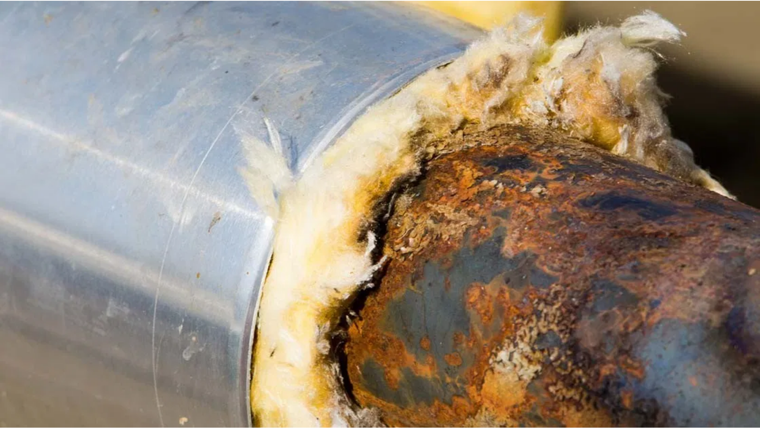
Introduction
The petrochemical industry faces
huge losses
from corrosion
Corrosion costs the global economy
$2.5 trillion annually
, equivalent to 3.4% of global GDP
Traditional inspection methods are
time-consuming
and
prone to human error
RustRadar
: An AI-powered solution that detects corrosion early, preventing costly failures and safety hazards

Slide 3
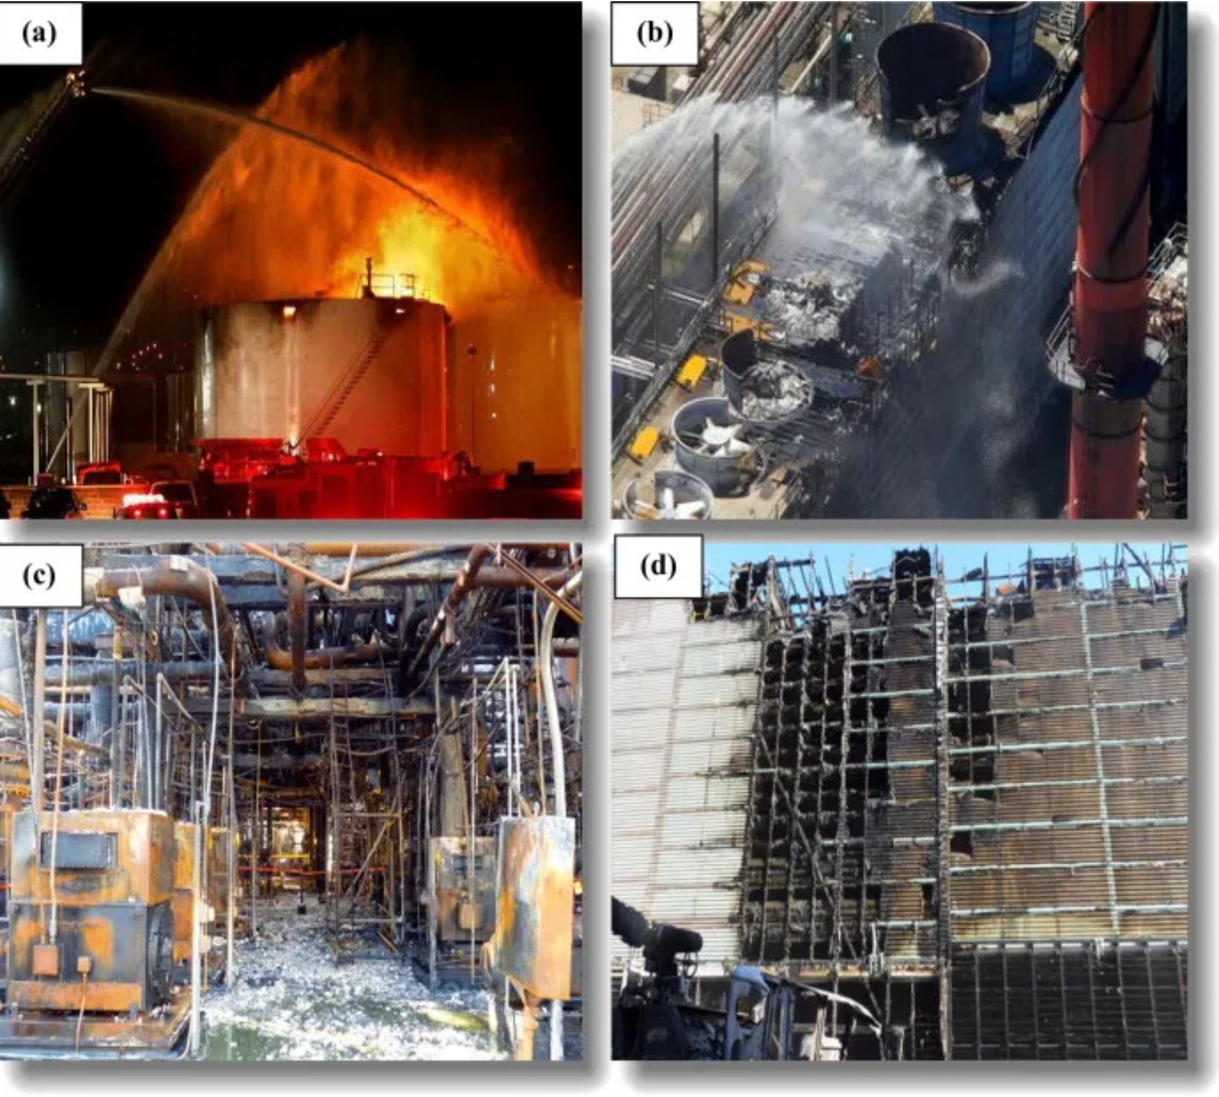




The Problem of Corrosion
Metal equipment in petrochemicals → exposure to
chemicals & humidity
(explosions, leaks, structural failures)
Corrosion leads to
safety hazards
and high maintenance costs
Results in
unplanned downtime
billions in yearly losses
Costs the petrochemical industry
and reduces equipment lifespan by 40%

Slide 4
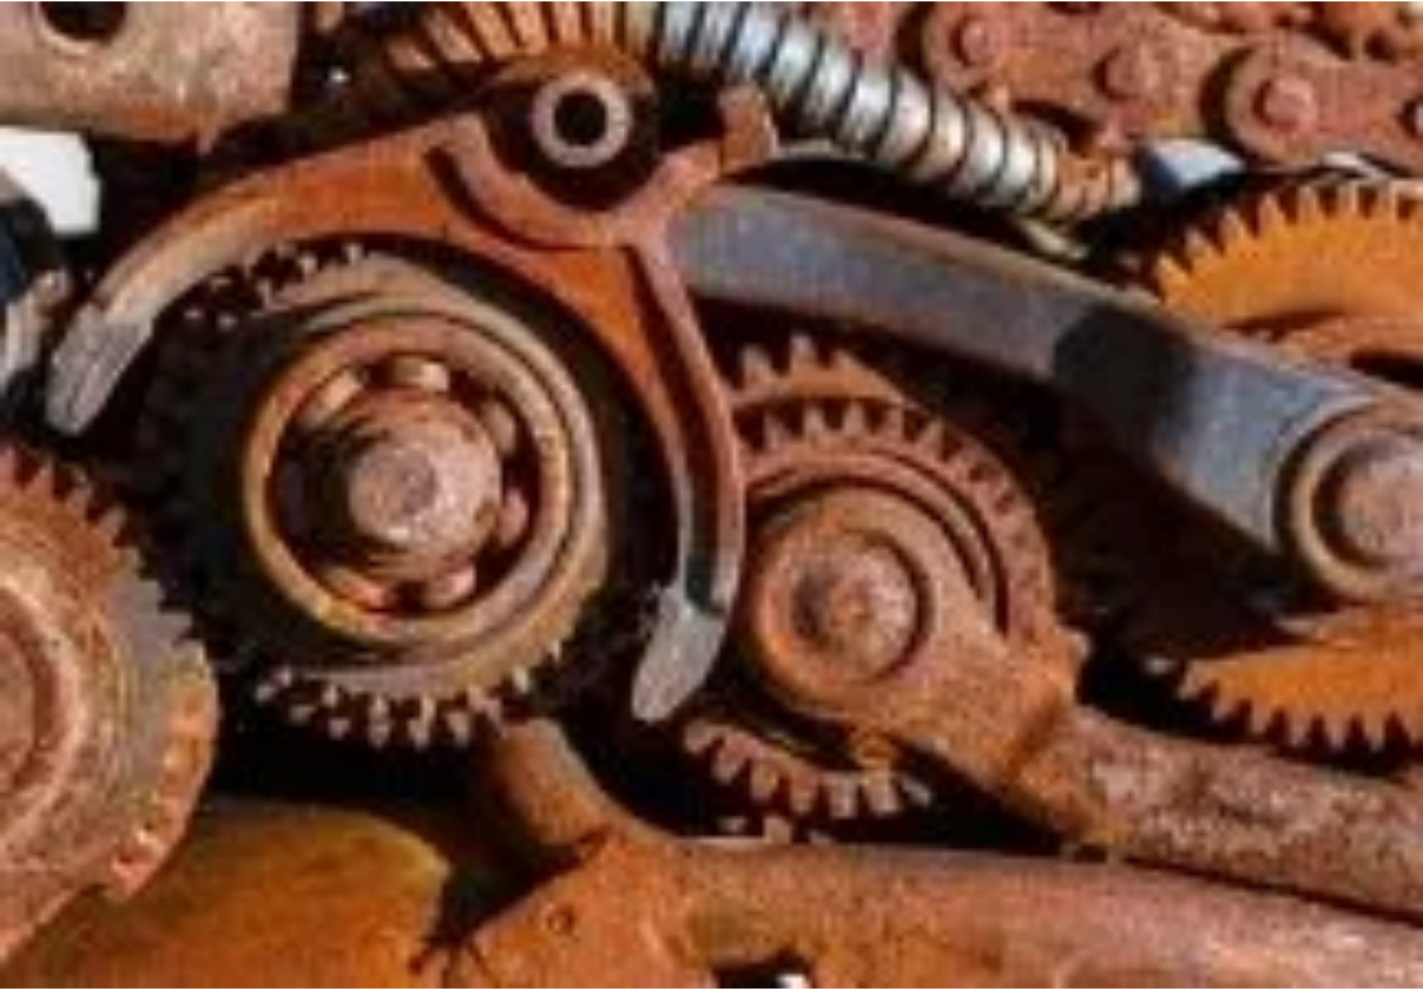
Current Challenges in Corrosion Detection
Time-consuming, subjective, and limited access to confined spaces
Manual inspection:
Varying expertise levels lead to missed early-stage corrosion
Inconsistent detection:
Detection often occurs after significant damage has already developed
Reactive approach:
Regular inspections require significant downtime and labor costs
Resource intensive:

Slide 5
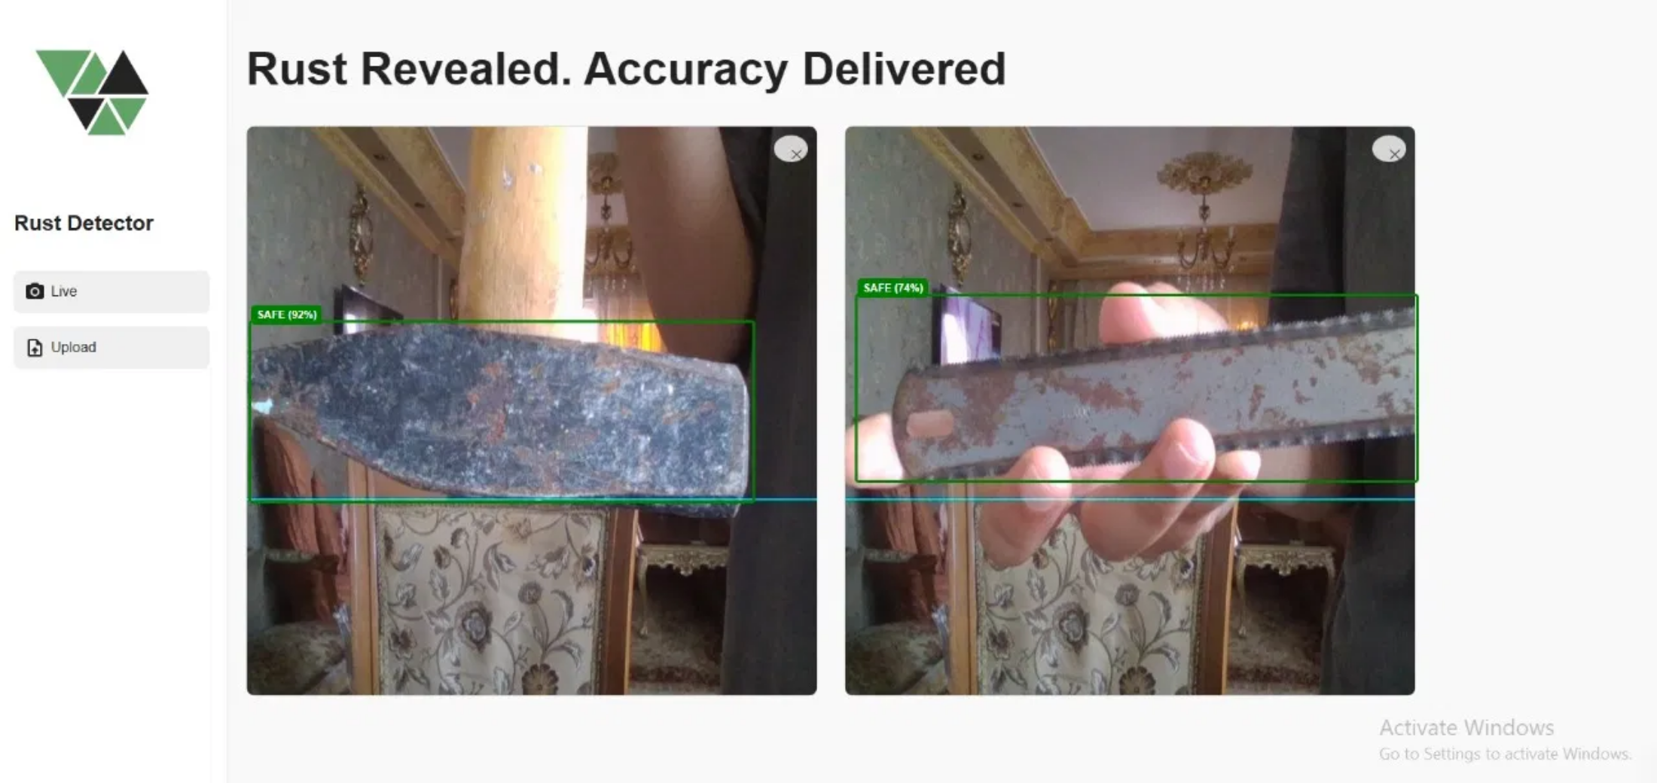
RustRadar Solution
RustRadar
: AI-powered corrosion detection system using YOLOv8 object detection
Automatically identifies and highlights corroded areas with
bounding boxes
Provides
and status indicators (SAFE/ALARM)
confidence scores
Accessible through web interface for
real-time analysis
Key Advantages
Early detection • Reduced inspection time • Higher accuracy • Consistent results • Accessible anywhere

Slide 6
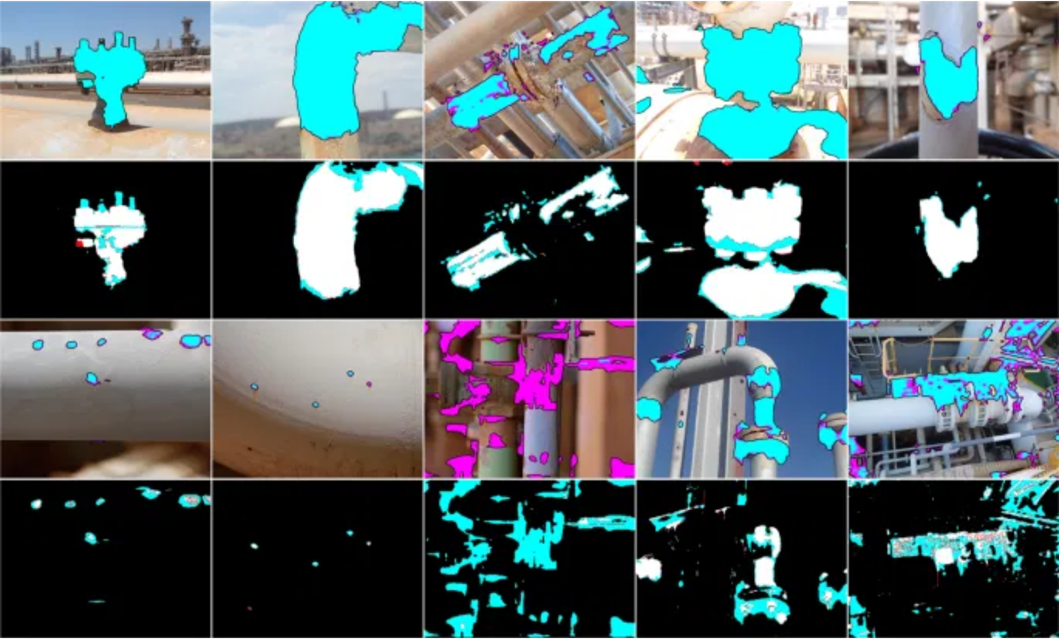
Technology Behind RustRadar
YOLOv8 Detection Model
: State-of-the-art object detection architecture optimized for real-time performance
Trained on
with labeled images of rusted surfaces
custom corrosion dataset
Advanced
capabilities identify subtle corrosion patterns that human inspectors might miss
feature extraction
Confidence threshold system:
≥0.7 → SAFE
(low corrosion risk)
＜0.7 → ALARM
(significant corrosion detected)
Training Specifications
Model trained with 50 epochs on GPU-accelerated environment using Kaggle, achieving high precision in corrosion identification

Slide 7

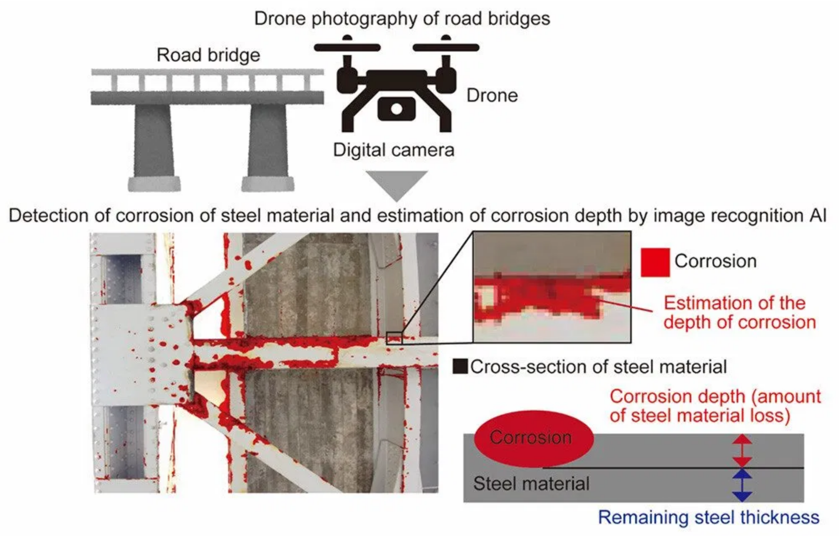



System Architecture
Dataset Preparation:
Images labeled for corrosion
using Roboflow, exported in YOLOv8 format
Model Training:
YOLOv8 Large trained for 50
epochs with GPU acceleration
API Deployment:
FastAPI backend deployed on
Hugging Face Spaces via Docker
Frontend Application:
Web interface for image
upload and visualization
The system processes images through the pipeline, applying
confidence thresholds:
≥0.7 →
SAFE
<0.7 →
ALARM

Slide 8
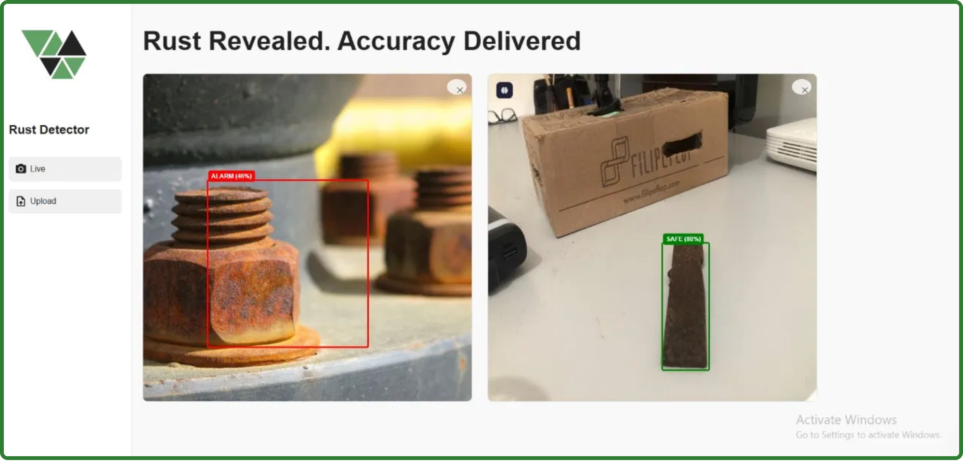
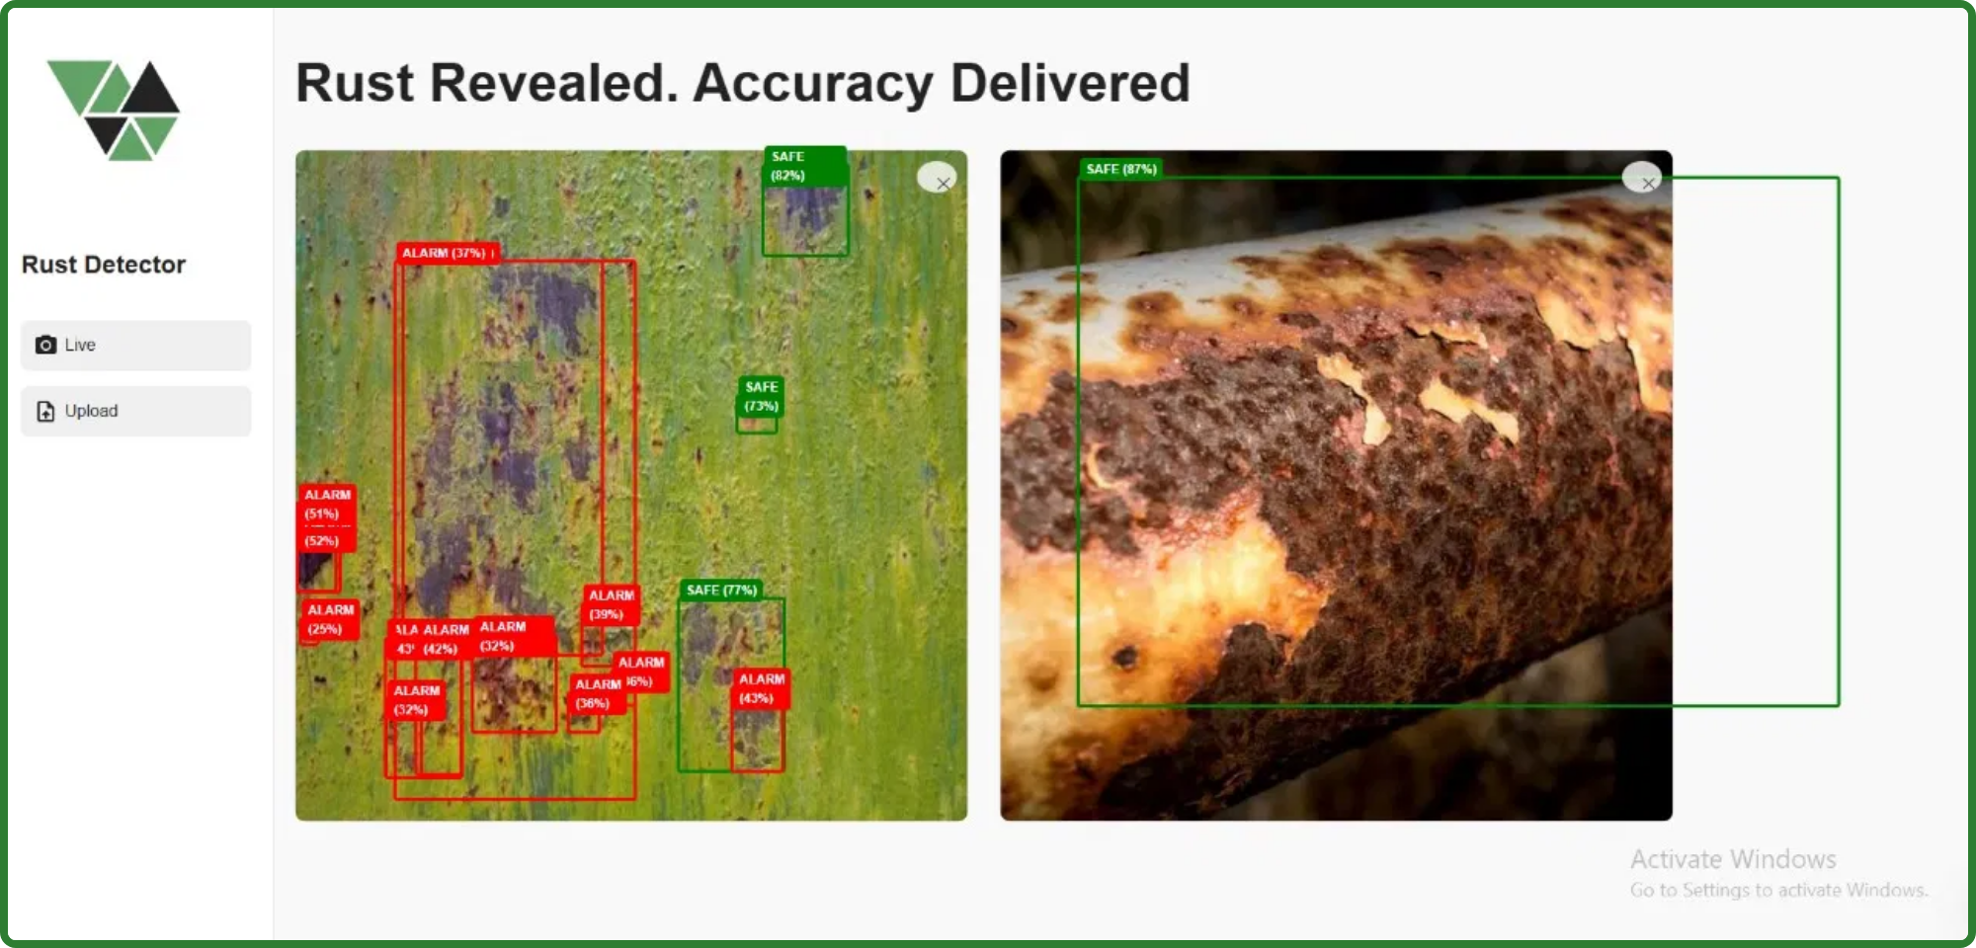
Demo & Results
RustRadar successfully
identifies corrosion
across various industrial objects and surfaces
Detection includes
showing the system's certainty level
confidence scores
Color-coded bounding boxes provide
instant visual feedback
:
Green boxes (SAFE)
: Low corrosion risk areas
Red boxes (ALARM)
: Significant corrosion detected
System processes images in
, enabling immediate decision-making for maintenance teams
real-time
SAFE (≥70% confidence)
ALARM (<70% confidence)

Slide 9

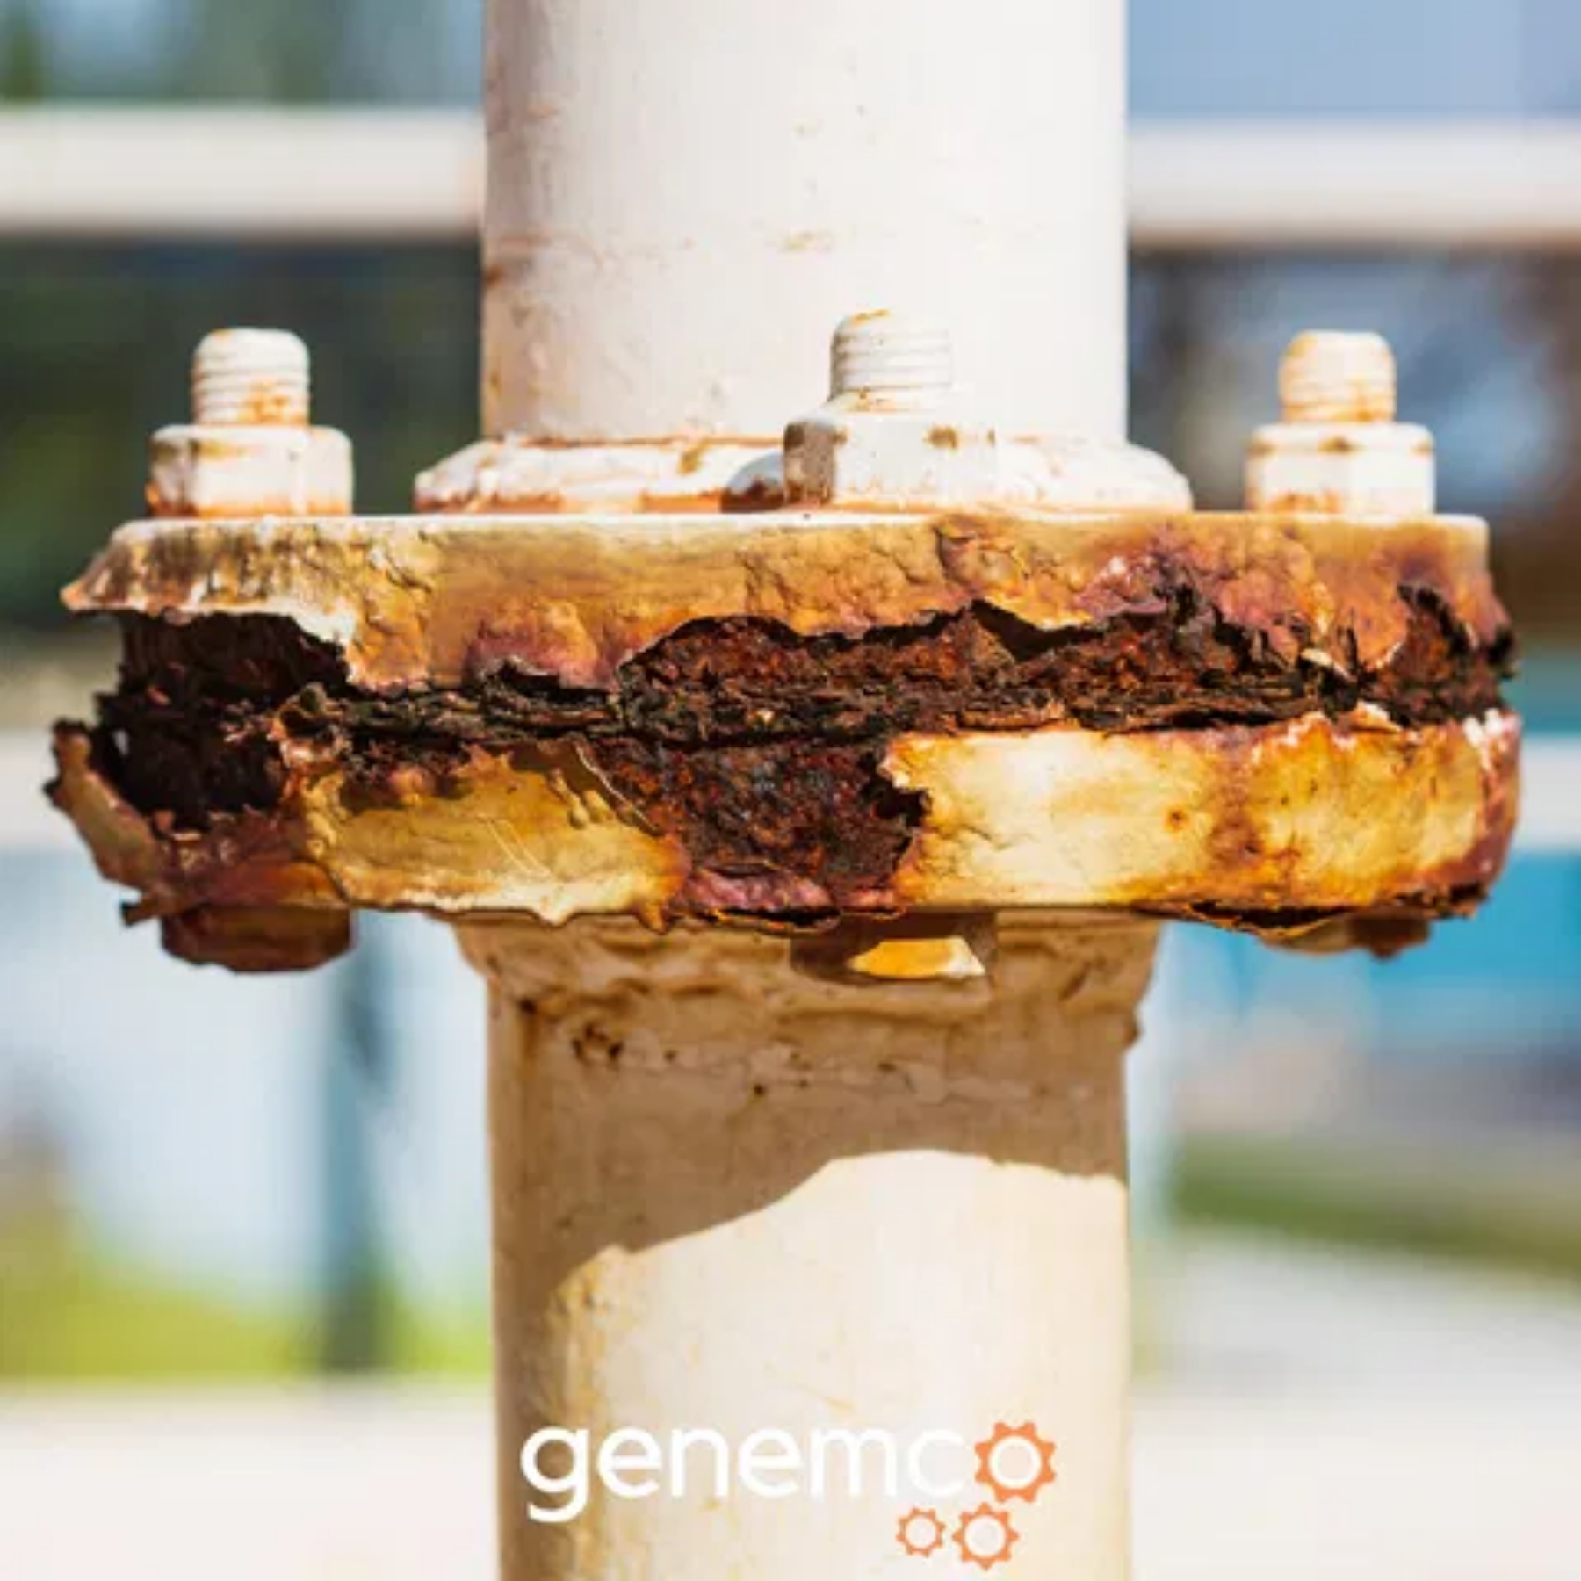



Benefits for Petrochemical Industry
Enhanced Safety:
Early detection of corrosion
prevents catastrophic failures, protecting
personnel and environment from hazardous leaks
and explosions
Cost Reduction:
Up to 35% reduction in
maintenance costs through preventive rather than
reactive maintenance
Extended Equipment Lifespan:
Proactive
maintenance extends asset life by 15-20%,
maximizing return on investment
Operational Efficiency:
Minimized unplanned
downtime and optimized maintenance scheduling
increases overall plant productivity

Slide 10
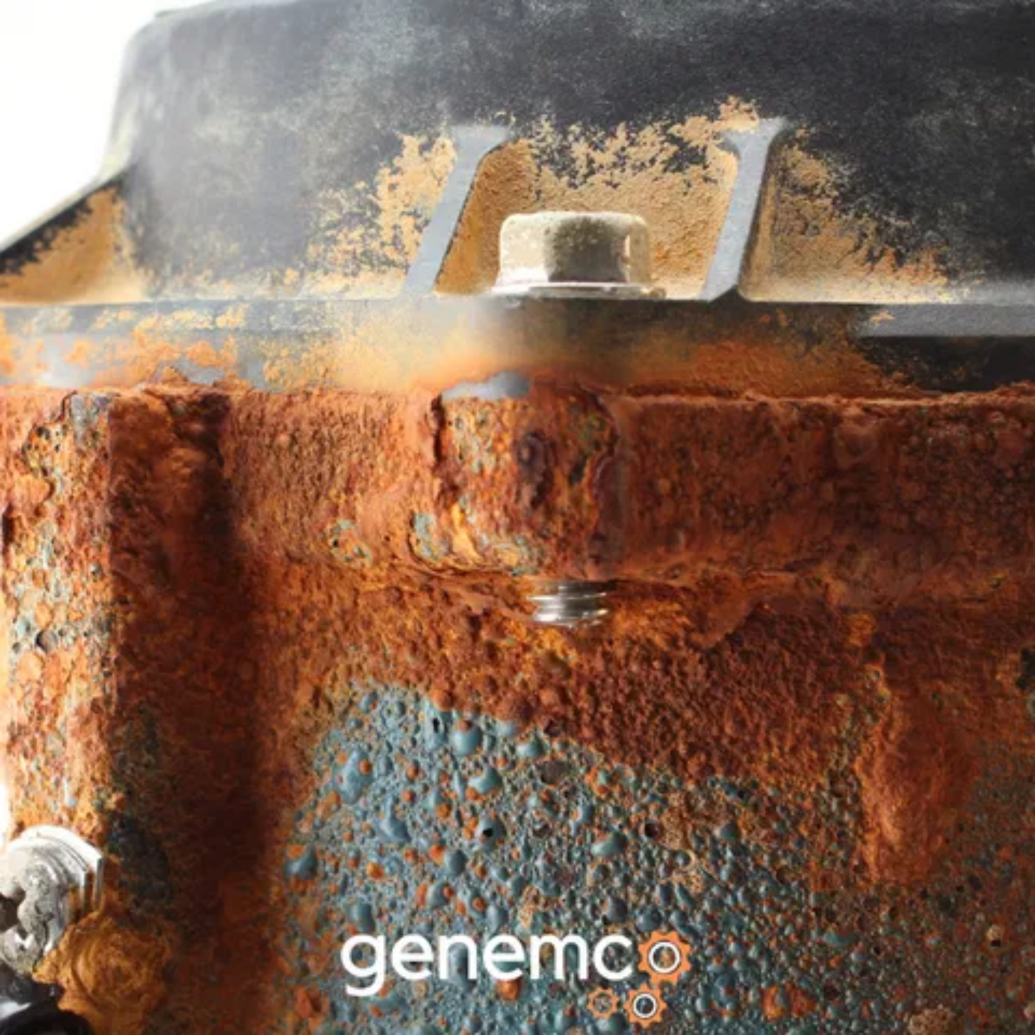
Conclusion & Future Enhancements
RustRadar successfully demonstrates an
end-to-end pipeline
for AI-powered corrosion detection
The system enhances safety and efficiency by
automating detection
, reducing reliance on manual inspections
Future Enhancements
Expanding the dataset with more diverse corrosion examples
Real-time video stream analysis for continuous monitoring
Mobile application for field inspections
Integration with maintenance management systems
Preventing costly failures through early detection

